Slide 1
COVID EXPLORER
By Harrison, Purvi, Paulina, Khushboo & Antonio

Slide 2
CONTENTS OF THIS PROJECT
MISSION STATEMENT: Develop a covid vaccine support program to help health institutes in analysing data, and provide a system for tracking vaccinated patients using blockchain technology.
COVID
EXPLORER
COVID BUDDY
BLOCKVAX
CONTRACT
Using Streamlit and Altair for dashboard Functionality,
Machine Learning Algorithms to analyse trends among different countries &
Python for other advanced data analysis.
Chat-bot to communicate and answer questions with the Public about covid related queries.
Using Solidity to create a patient contract to verify whether patient has been vaccinated or not.
DATA SOURCE: https://github.com/owid/covid-19-data
We implemented a function to download the latest data from the website.

Slide 3
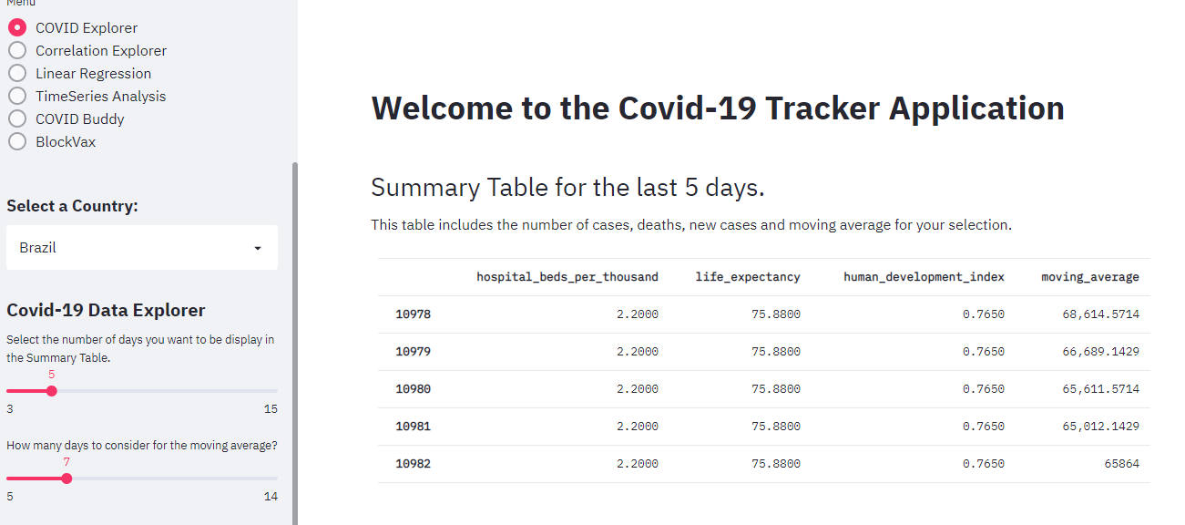
COVID DATA EXPLORER

Slide 4
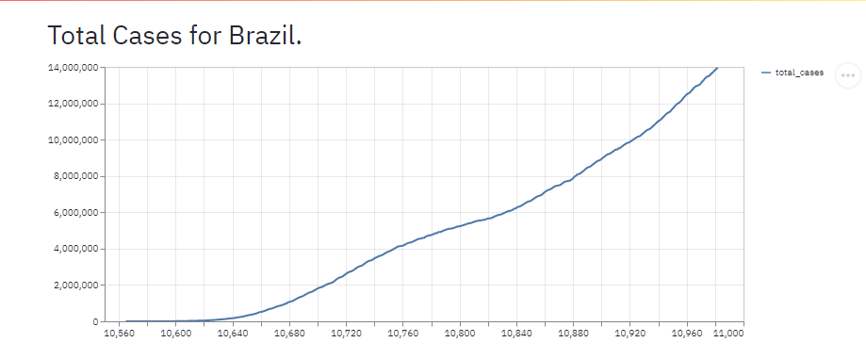
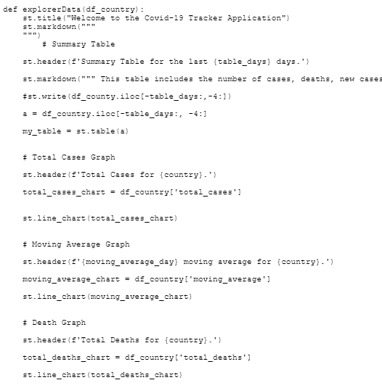
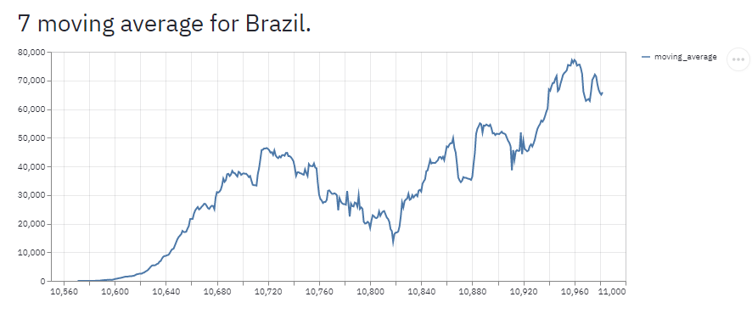
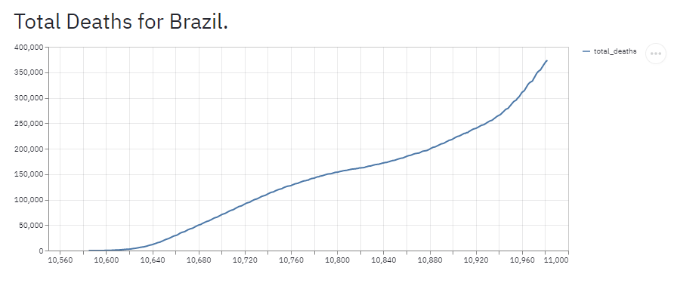
COVID EXPLORER GRAPHS

Slide 5
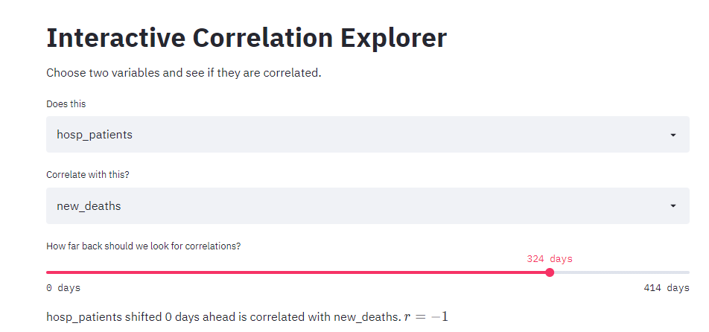
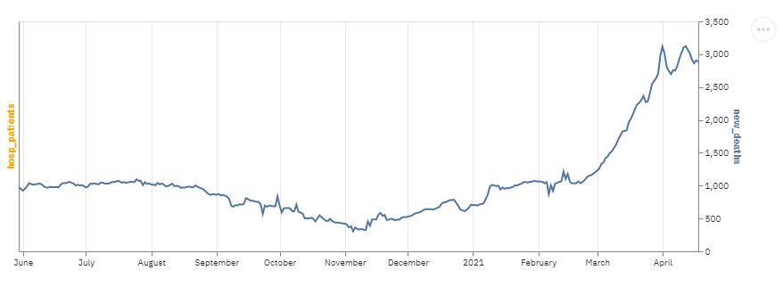
COVID EXPLORER - CORRELATIONS
This function was developed to check whether variables are correlated.
Out of 56 variables in our data set only 7 variables are used to compare correlation data.
Based on the total data available in the csv file, the program is calculates how many days worth of data is available.
Using the Slider, we choose the number of days we want to plot the correlation between two variables for.

Slide 6
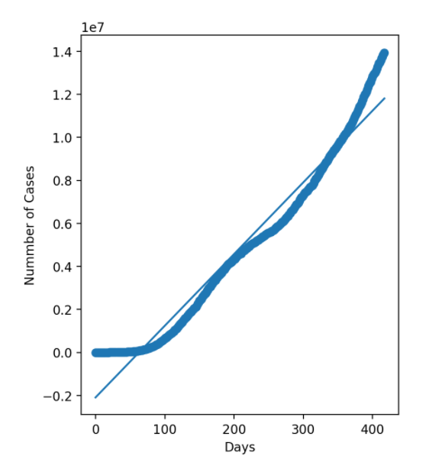
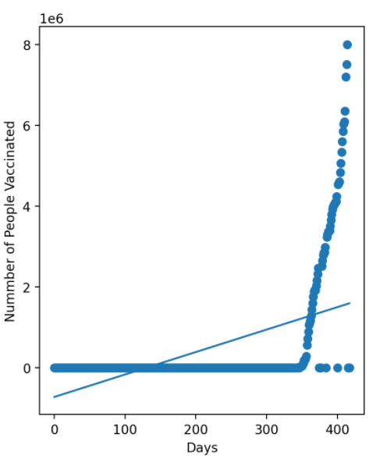
COVID EXPLORER – LINEAR REGRESSIONS
PREDICTED TREND OF BRAZIL COVID CASES USING LINEAR REGRESSION
PREDICTED TREND OF BRAZIL VACCINATIONS USING LINEAR REGRESSION

Slide 7
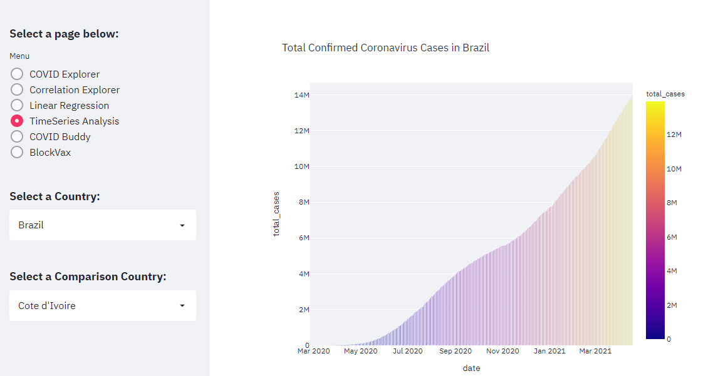
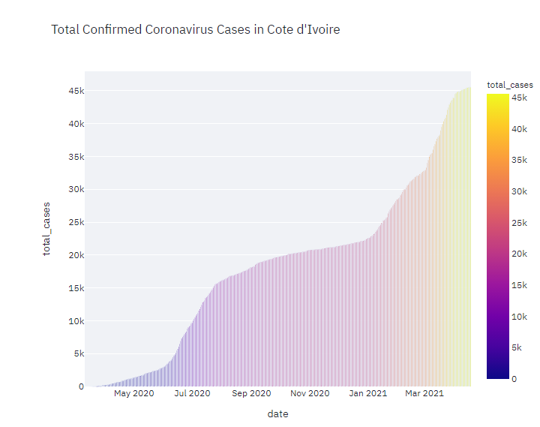
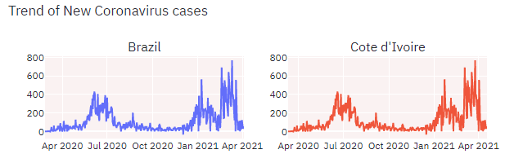
COVID EXPLORER – TIME SERIES

Slide 8
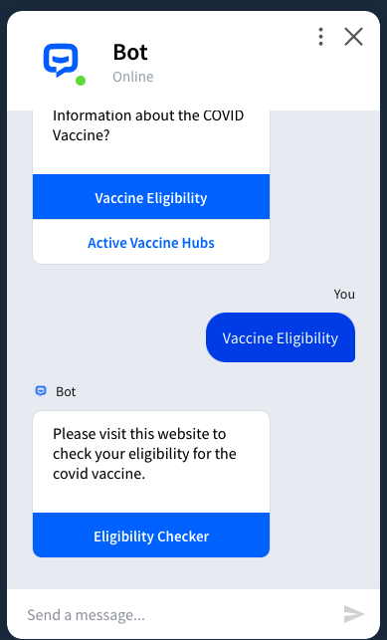
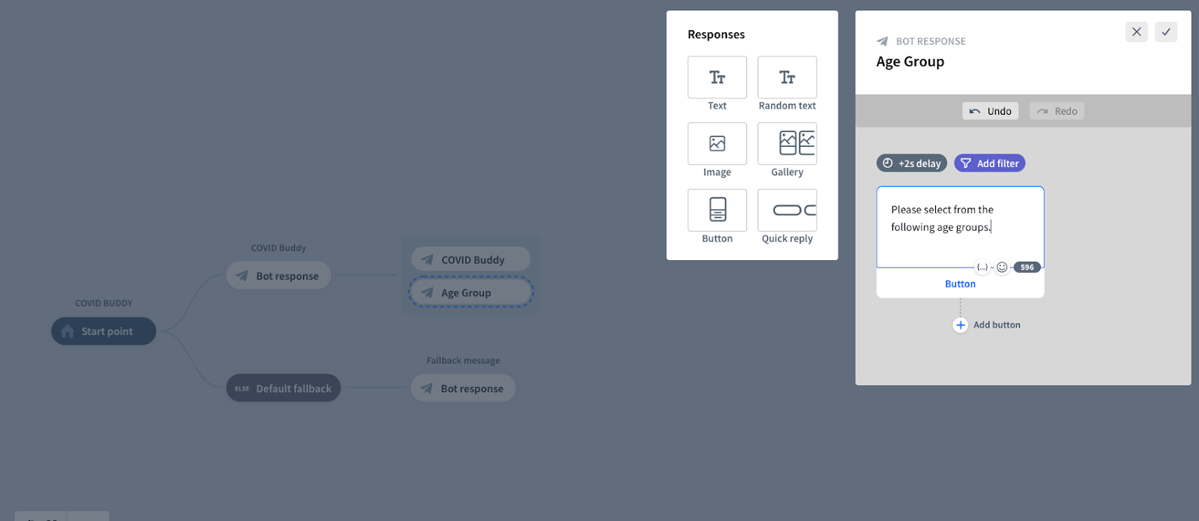
COVID BUDDY – INTERACTIVE CHATBOT
CHAT BOT FUNCTIONALITY

Slide 9

COVID BUDDY
https://app.chatbot.com/dashboard/608903c2be6c8d0007f958a1

Slide 10


BLOCK VAX
Smart Contract - 3 Functions
User Registration
Address
Patient ID Number
Photo ID (URI)
Vaccine Data Update
Registered Provider
Vaccine Name
Mint ERC721 Token (VAX)
Set Token URI
Vaccinated Profile Check
x

Slide 11
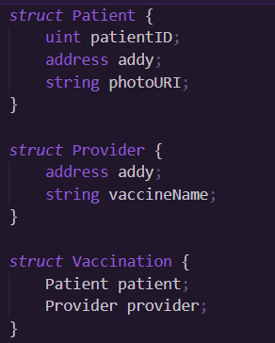
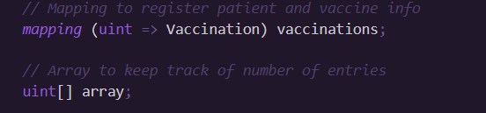
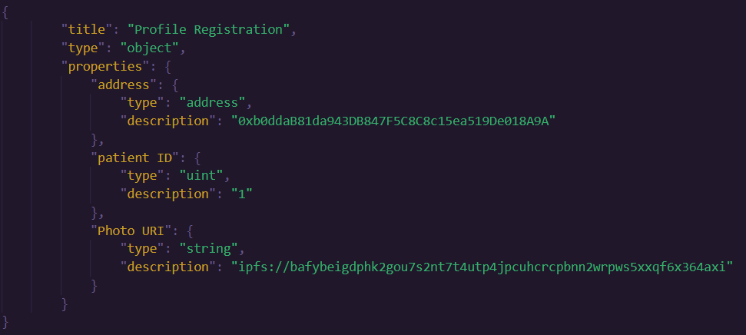
BLOCK VAX PROFILE & VACCINE REGISTRATION

Slide 12
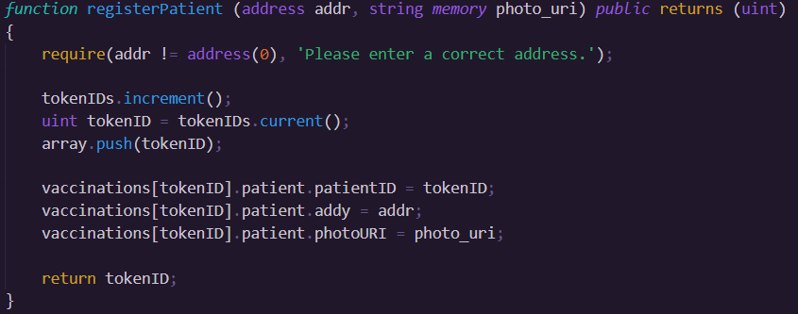
BLOCK VAX PATIENT REGISTRATION

Slide 13
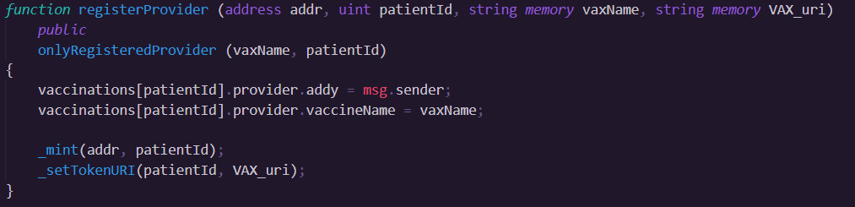
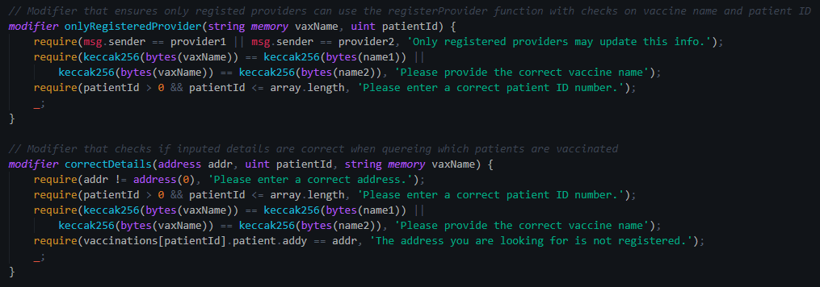
BLOCK VAX REGISTER PROVIDERS & VALIDATE

Slide 14
Demonstration

Slide 15
HOW CAN THIS PROGRAM GET TO THE NEXT LEVEL?
CHATBOT COMPLEXITY
BLOCKVAX USECASE
MORE DATA

Slide 16
Questions ?

